Slide 1

DATA ANALYST
job search
MARIAMA Yasmine

Slide 2
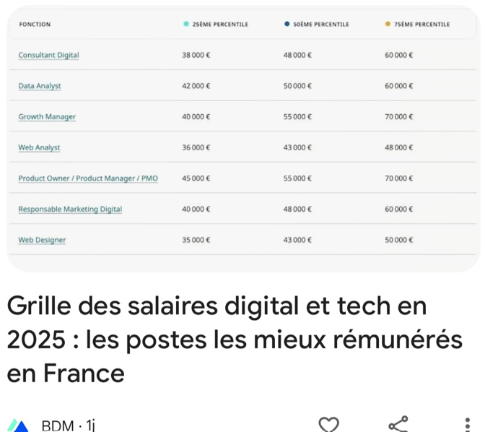
starting point
An article showing jobs with highest salary in France
⇒ my question was, what the tendency market digital and tech jobs in France?
My Api choice = JSearch
JSearch is a recruitment firm
Endpoint = job search
⇒My search was “Data analyst in France”

Slide 3
Difficulties and learns
Data available in the APIs evolves
⇒ save DataFrame in a CSV file
Informations in some columns were in a dictionary
⇒ Flat DataFrame by using pd.json_normalize()
Large number of columns (53) but:
majority of them is NaN (‘employers_compagny_type’…)
no interesting information to exploit in this case (‘employer_logo', 'employer_website','job_latitude', 'job_longitude’,'job_google_link’ ….)
Boolean

Slide 4
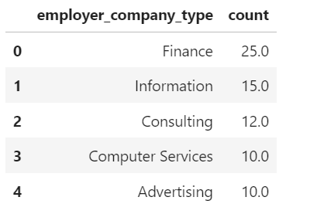
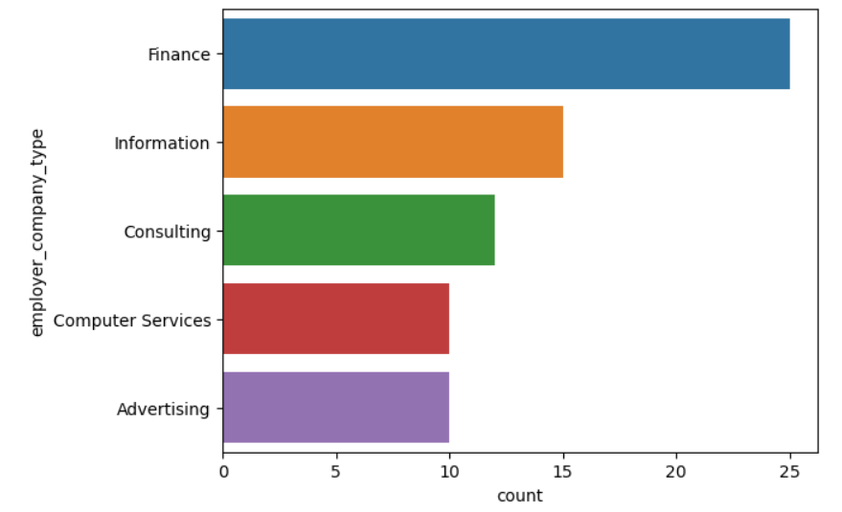
Jobs offers by type of compagnies
Top 5 companies recruiting in %

Slide 5
Required experience
required_experience_in_months: 78% missing values
required_experience_in_months %
36.0 38.2
60.0 32.4
12.0 8.8
120.0 5.9
24.0 5.9
48.0 2.9
84.0 2.9
360.0 2.9

Slide 6
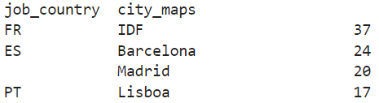
jobs search by localisation
Jobs are principaly in large cities

Slide 7
Conclusion
1. You have more chance to find a job in a big city.
In France, jobs are focus on Paris
2. An expérience is generally requiered
3. The salary depend of the expérience

Slide 8
Thank you!

